Slide 1
Improvisation of ITS Technology In VANET
Submitted by
Rahman, Mahfuzur - 16-32638-3
Dev, Shovan - 16-32625-3
Wahid, Nasim - 17-33095-1
Shuvo, Saiful Islam - 16-32620-3

Slide 2
Content
Motivation
VANET(Vehicular Ad-hoc Network)
ITS(Intelligent Transportation Systems) Technology
ITS in the connected world
Related Work
Objective
Proposed Method
Flowchart
Analysis and Comparison
Software Engineering Model
Conclusion and Future Improvement

Slide 3
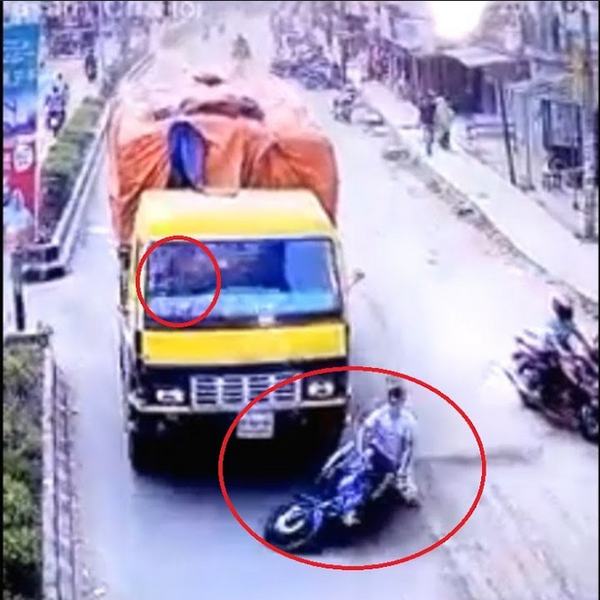
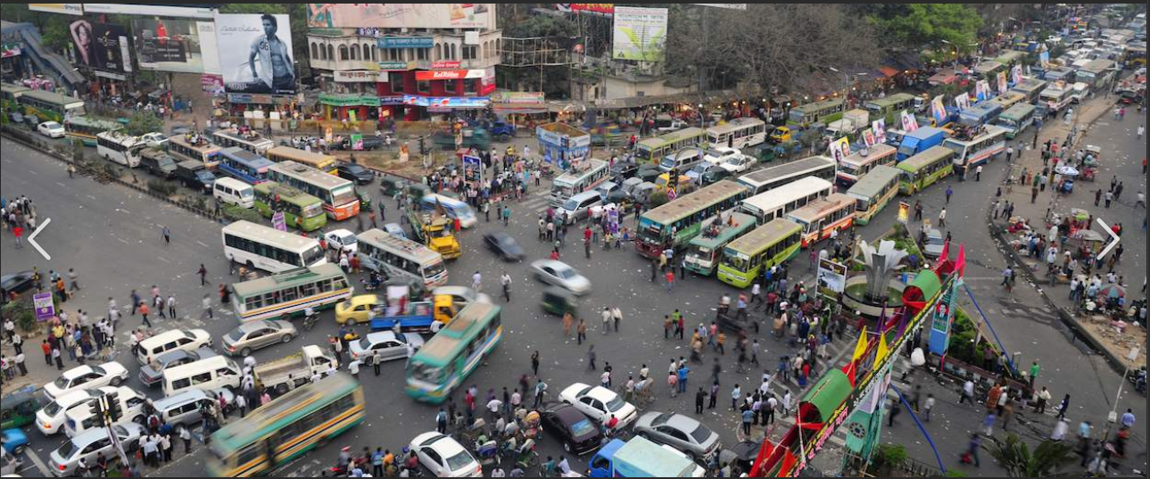
Motivation
Road accident and transportation problems.
Traffic jam and collisions.
Benefit and safety for the common people.
Hassle-free lifestyle.
Easy driving experience.
Automated vehicle improvisation.
Application of ITS technology
and it's improvisation.

Slide 4
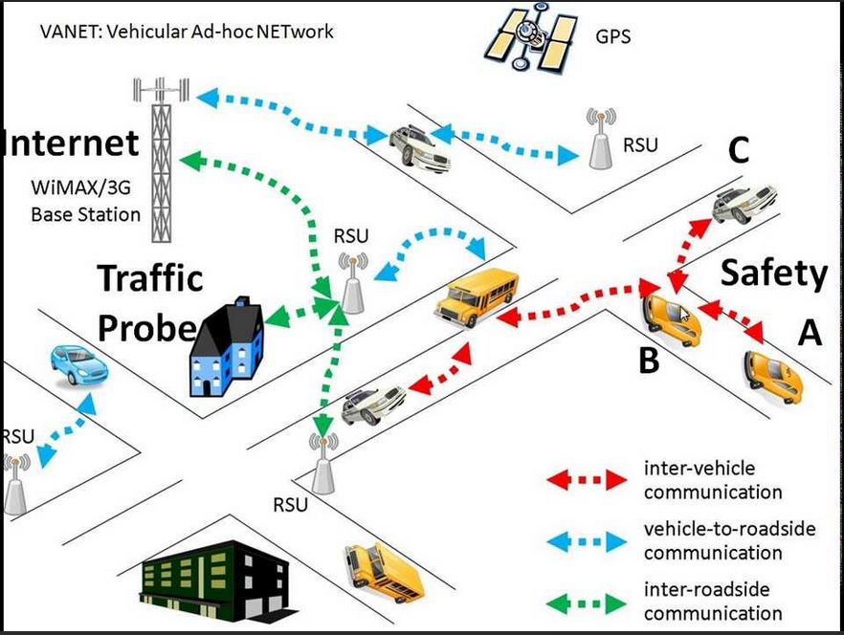
VANET(Vehicular Ad-hoc Network)
Deployed on the road, where vehicles constitute mobile nodes.
VANET can be considered as device of ITS.
Active security and intelligent transportation.
vehicle-to-vehicle communication technology.
Features
prevention of collisions.
safety.
blind crossing.
dynamic route scheduling.
real-time traffic condition monitoring.

Slide 5
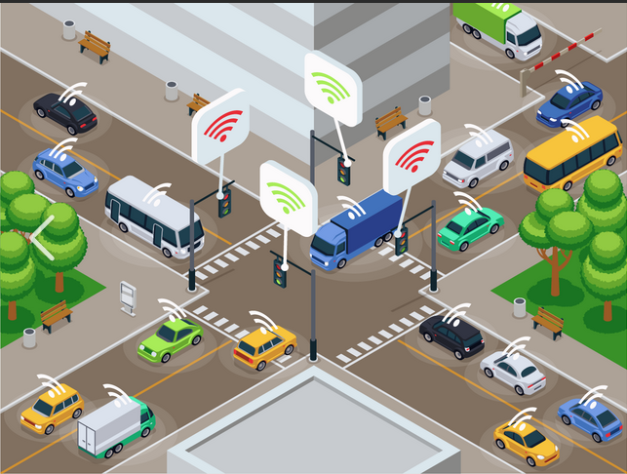
ITS(Intelligent Transportation Systems) Technology
An advanced application.
Enable users to be better informed and make safer.
More coordinated and smarter use of transport networks.
Provide innovative services relating to different modes of
transport and traffic management.
Automated Road Enforcement
Speed cameras iv. Red light cameras .
Bus lane cameras v. Level crossing cameras .
Double white line cameras. vi. High-occupancy vehicle lane cameras.

Slide 6
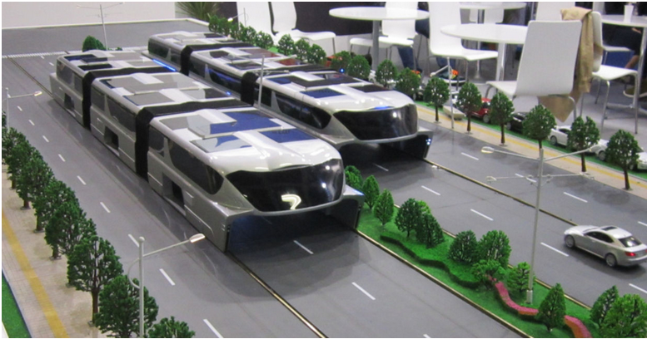
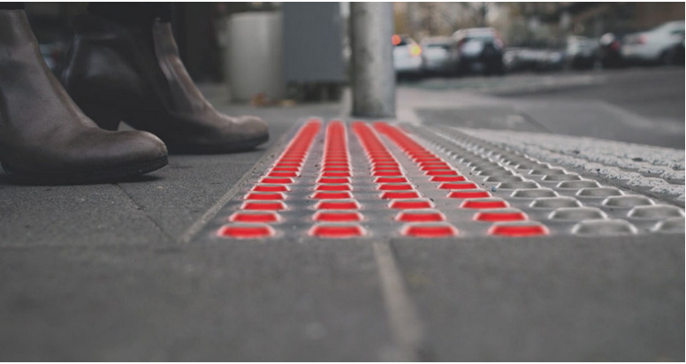
ITS in the connected world
THE CHINESE STRADDLING BUS
GROUND LEVEL PEDESTRIAN TRAFFIC LIGHTS
Car navigation system.
Traffic signal control systems.
Automatic number plate recognition and Security CCTV systems.
Automatic incident detection and Stopped vehicle detection systems.
Parking guidance and Weather information system.

Slide 7
Related Work
Mohammed Saad Talib (Author) “Vehicular Ad hoc Network for Intelligent Transport System: A review”
Revealed a challenge covering Vehicle-to-Vehicle (V2V) style.
Reduced the transmission overhead and improvement of street security.
Ganesh S. Khekare (Author) “A Smart City Framework for Intelligent Traffic System Using VANET”
Intelligent Traffic Lights (ITLs) as Road Side Tower.
Transmit warning messages and traffic statistics.

Slide 8
Objective
Improving the transportation system.
Reducing risk of potential accidents.
Reducing the traffic jams.
Improving the ITS technology for VANET.
Proving the advantage of automated vehicle.

Slide 9
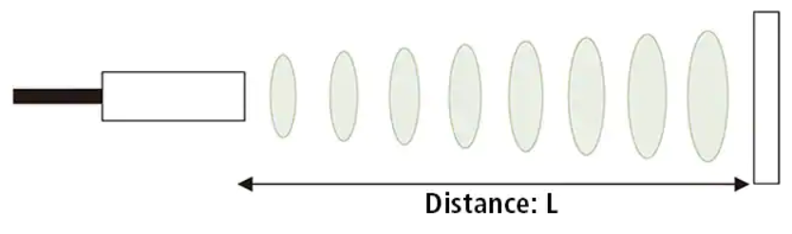
Ultrasonic Sensor Road Side Tower
Proposed Method
Measure distance by using ultrasonic waves.
Detect any object.
Even transparent targets can be detected.
Detection is not affected by accumulation of dust or dirt.
All the mobile network tower will play this role.
Connect with the main sensor.
Gather information and updates.
Inform the nearest hospital.
Inform the nearest police station.
Distance L = 1/2 × T × C

Slide 10
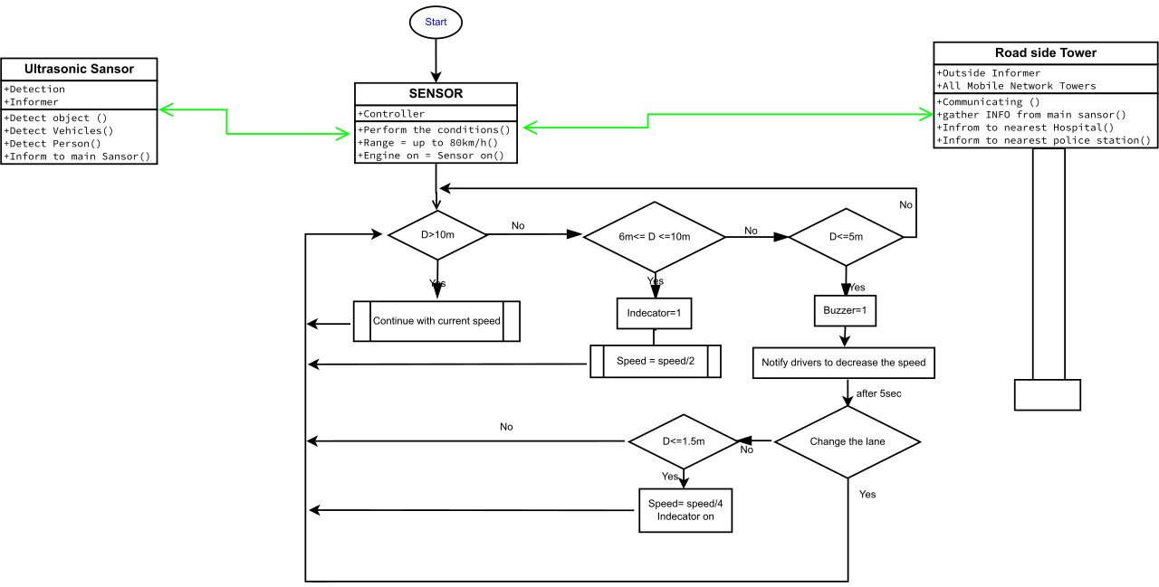
Flowchart
Flowchart for the ITS technology that we plan to use for our safety.

Slide 11
Analysis
This improvised technology can - manage a decent speed control system. - measure the distance of an object. - perform any action with engine directly. - A good communication with the driver also by notifying the action.
- minimize the risk of collisions and also traffic jam.
Comparison
Previous Work | Proposed Work
Vehicle-to-Vehicle (V2V) style. | Object-to-Object (O2O) style.
Intelligent Traffic Lights (ITLs) as Road Side Tower. | Mobile Network Towers as Road Side Tower.
Solution: Using Signal Control, ITLs, Routing Protocol. | Solution: Using Ultrasonic Sensor, Flowchart and also backup Pseudocode.
Motive: Either reduce Traffic Jams or Public Safety. | Motive: Reduce Traffic Jams and Public Safety both.

Slide 12
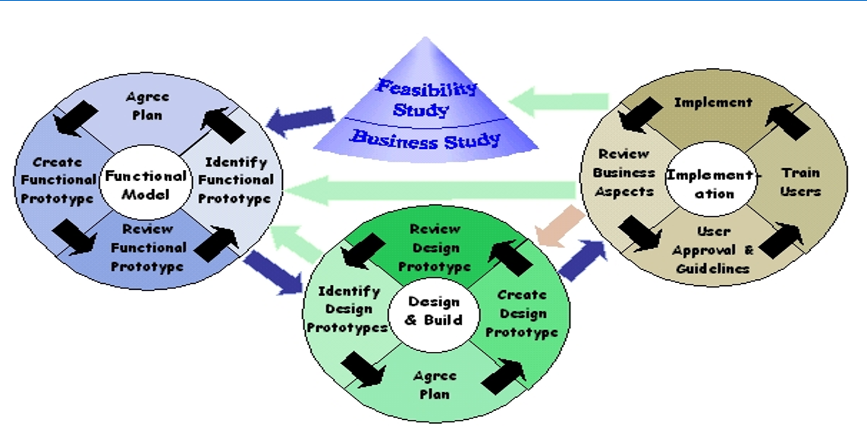
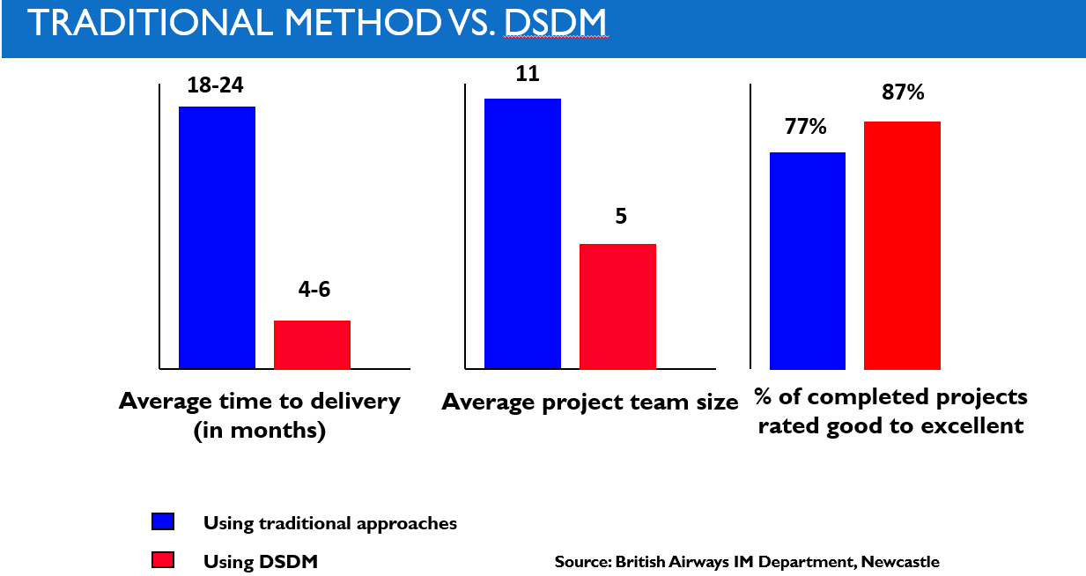
Software Engineering Model
Dynamic Systems Development Method (DSDM)
Why we should choose this one?

Slide 13
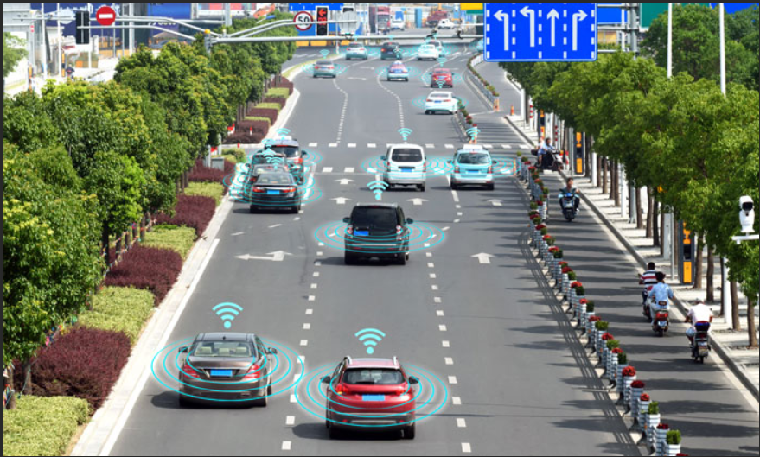
Conclusion
A new scheme is proposed.
Different works about ITS are compared.
The key idea is to create a smart city framework for VANET.
Consists a smart and safe transport system.
A good impact on our Environment and Sustainability.
Should use the system ethically by ourselves.
Govt. help which is also necessary for this big change.
Future Improvement
Start implement the proposed work.
Improvised edition but different from all the previous ones.
Activate the real security and intelligent transport.
Provides more safety and make the system more user friendly.
Reduces sound pollution.
Also reduce the cost in future.
Make the system more communicating and automated.

Slide 14
REFERENCES
Ganesh Khekare, Apeksha Sakhare, Department of Computer Science and Engineering, G. H. Raisoni College of Engineering, “A Smart City Framework for Intelligent Traffic System Using VANET”, Conference Paper · March 2013
Mohammed Saad Talib, Aslinda Hassan, Burairah Hussin, Ali Abdul-Jabbar Mohammed, Ali Abdulhussian Hassan, Ammar Awad Mutlag, Faculty of Information and Communication Technology, Universiti Teknikal Malaysia Melaka (UTeM) - Malaysia College of Administration and Economics, University of Babylon – Iraq, Faculty of Information and Communication Technology, Universiti Teknikal Malaysia Melaka (UTeM) - Malaysia, Faculty of Information and Communication Technology, Universiti Teknikal Malaysia Melaka (UTeM) – Malaysia, “Vehicular Ad hoc Network for Intelligent Transport System: A review”, International Journal of Engineering & Technology, 7 (4.36) (2018) 350-353
A.FITAH, A.BADRI, M.MOUGHIT, A.SAHEL, EEA & TI Laboratory Faculty of Sciences and Techniques of Mohammedia (FSTM), Hassan II University of Casablanca, BP 146, Mohammedia, “Performance of DSRC and WIFI for Intelligent Transport Systems in VANET”, Procedia Computer Science 127 (2018) 360–368
Sandhaya Kohli, Bandanjot Kaur, Sabina Bindra, Dept. of CSE, RIMT-IMT, Dept. of CSE, RIMT-IET, “A comparative study of Routing Protocols in VANET”
Ganesh S. Khekare, Apeksha V. Sakhare, Department of Computer Science and Engineering, G. H. Raisoni College of Engineering, “Intelligent Traffic System for VANET: A Survey”, International Journal of Advanced Computer Research (ISSN (print): 2249-7277 ISSN (online): 2277-7970) Volume-2 Number-4 Issue-6 December-2012
Pallavi A. Targe, M. P. Satone, PhD, PG Student, Department of E&TC, K. K. Wagh Institute of Engineering Education, Professor, Department of E&TC, “VANET based Real-Time Intelligent Transportation System”, International Journal of Computer Applications (0975 – 8887), Volume 145 – No.4, July 2016
Channakeshava RN, Dr, Meenatchi Sundaram. IMPROVISATION OF SIGNAL QUALITY IN CELLULAR IOT IN VANET. JCR. 2020; 7(14): 1460-1463. doi:10.31838/jcr.07.14.330
Y.A.Dahou Djilali1, Y.Bakhti1, B.Kouninef1, B.Senouci2, “Performances Evaluation study of VANET Communication Technologies for Smart and Autonomous Vehicles”, Conference Paper · July 2018.

Slide 15
THANK YOU

Slide 16
Pseudocode
Step-1 : Initialize
Step-2 : ITS sensor = 1 [Objects max speed will be locked at 80 km/h] Ultrasonic sensor is connected to ITS sensor (Ultrasonic sensor is being used for distance measurement between Object to Object )
Step-3 : If O2O Distance > 10 meters; then Object speed will not be changed .
Step-4 : If O2O Distance < 10 meters: Object speed will be decreasing gradually, until speed = ½ of previous speed.
Step-5 : If O2O distance <= 5 meters ; Alarm will be on for notifying drivers to decrease the speed to change the lane of that object [If it is done ,then go to step-3 ]
Step-6 : If O2O distance <=1.5 meters ,speed =1/4 Besides Object indicators light turns on -and after 2 sec brake lever will be pressed automatically. [If speed will not be decreased]

